Slide 1
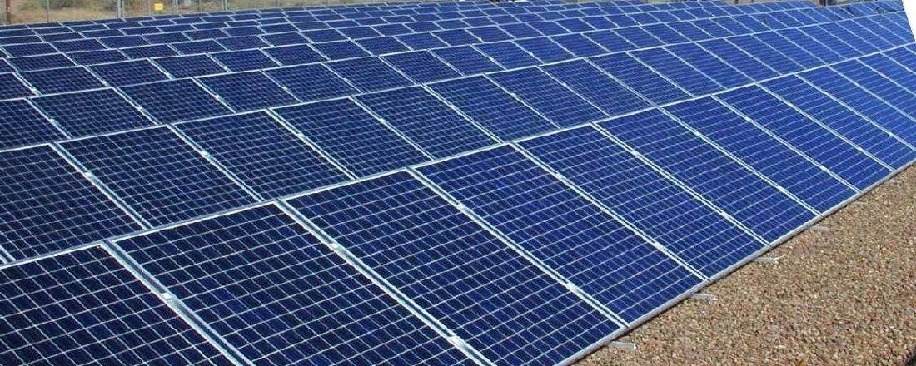
SOLAR POWER SOLUTION FOR PETROL PUMP
APPLICATIONS
TECHNICAL OVERVIEW
BY
DIAMOND GREEN ENERGY CORPORATION

Slide 2

OVERVIEW
PROVIDE BUILDING INTEGRATED SOLAR PHOTOVOLTAIC POWER SOLUTIONFOR PETROL PUMPS.
PROVIDE LED LIGHTS HAVING EQUIVALENT ILLUMINATION AS METAL HALIDE LIGHTS USED IN CANOPY OR AS STREET LIGHTS.
TO PROVIDE SOLUTION FOR SAVING OF DIESEL WHERE THE PUMPS ARE RUN BY GENERATOR SETS.
SOLAR POWERED PLANT IS ONLY SOLUTION WITH LONG LIFE AND MINIMUM MAINTENANCE.

Slide 3
Advantages
Availability of clean power , which ensures effective operation and performance of PETROL PUMPS.
Reduction of operational cost. And Carbon emissions.
Negligible maintenance.
Noise free.
Independent of other modes of electrical infrastructure.

Slide 4
System Configuration
The Solar systems are designed to provide either DC or AC output power depending on type of load. Most PETROL PUMPS OPERATE ON DIESEL GENERATOR IN RURAL AREAS WHERE POWER SUPPLY IS IRREGULAR. Typical system sizes are 5 KVA AND 10 KVA CAPACITY.
The system provides sufficient energy for the specific applications and store the energy in TUBULAR FLOODED batteries. Depending on specific requirements, the system can be configured to store and provide Solar energy TO RUN FROM MORNING 7 AM TO EVENING 9.00 PM.

Slide 5
SCOPE OF SUPPLY
SOLAR POWER CONDITIONING UNIT CAPACITY-----5 KVA 96V OR 7.5 KVA 120v
SOLAR PANELS ---------2.4 KWp/5.0 KWp
SOLAR TUBULAR FLOODED BATTERY-180/200 AH 12V.
SOLAR PANEL MOUNTING STRUCTURE.
LED LIGHTS AS PER REQUIREMENT ON EXTRA COST.

Slide 6
CONCLUSION
THE PURPOSE OF THE PROJECT IS TO REDUCE THE AMOUNT OF POWER CONSUMPTION AND ALSO RUN THE PETROL PUMP IRRESPECTIVE OF ANY GRID SUPPLY SO THAT THE SAVINGS ON DIESEL ARE GENERATED INTO PROFIT.

Slide 7
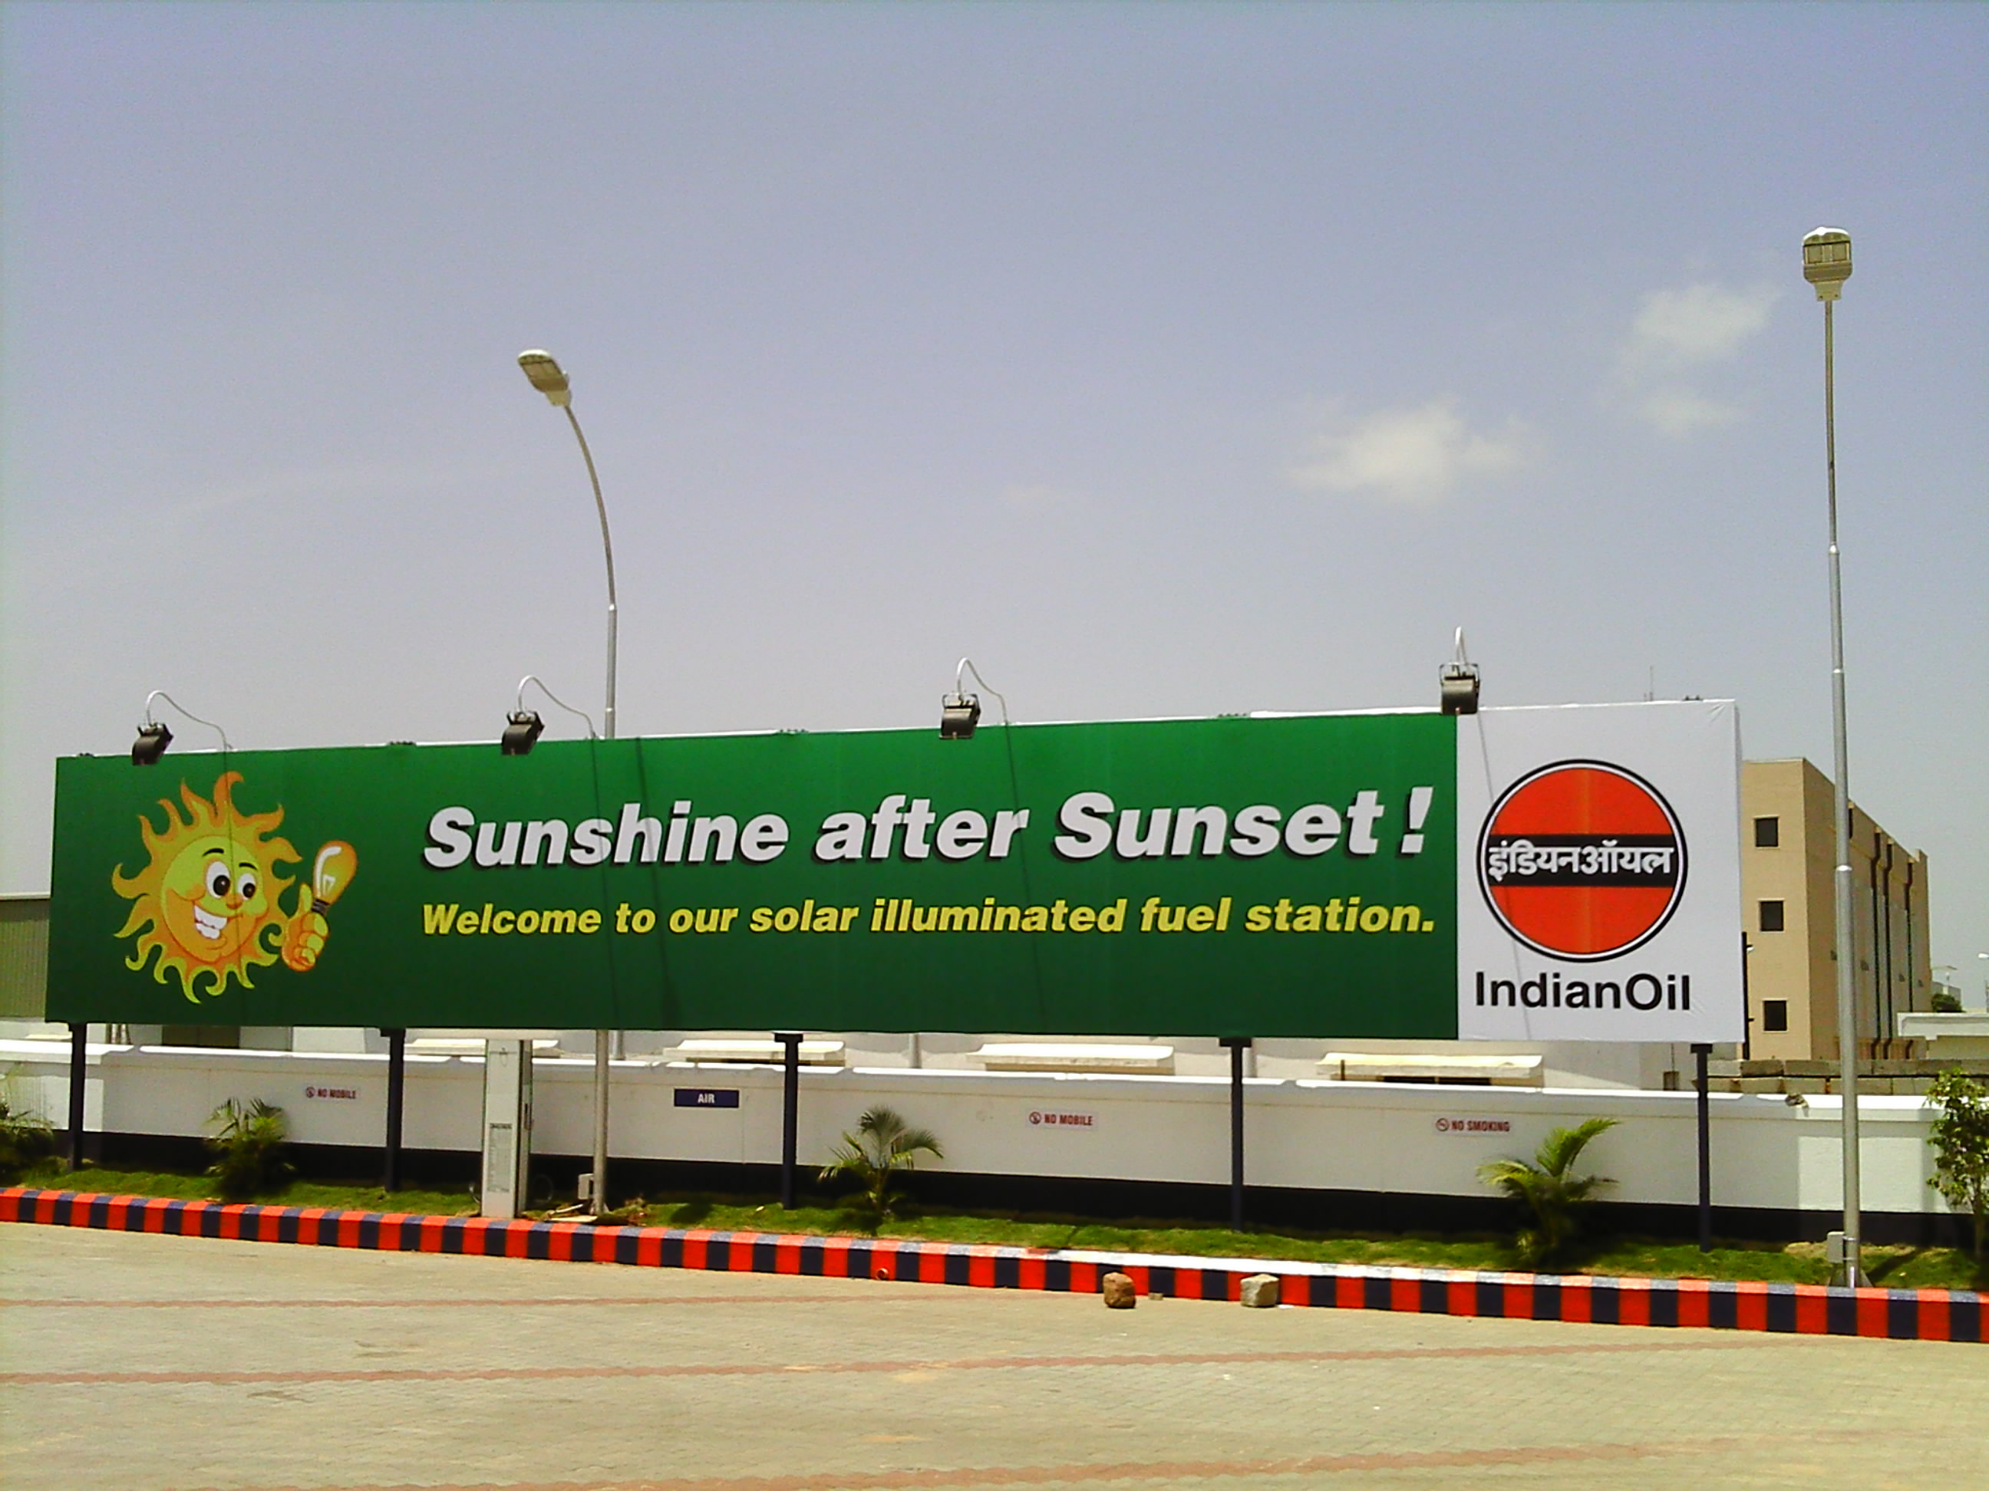
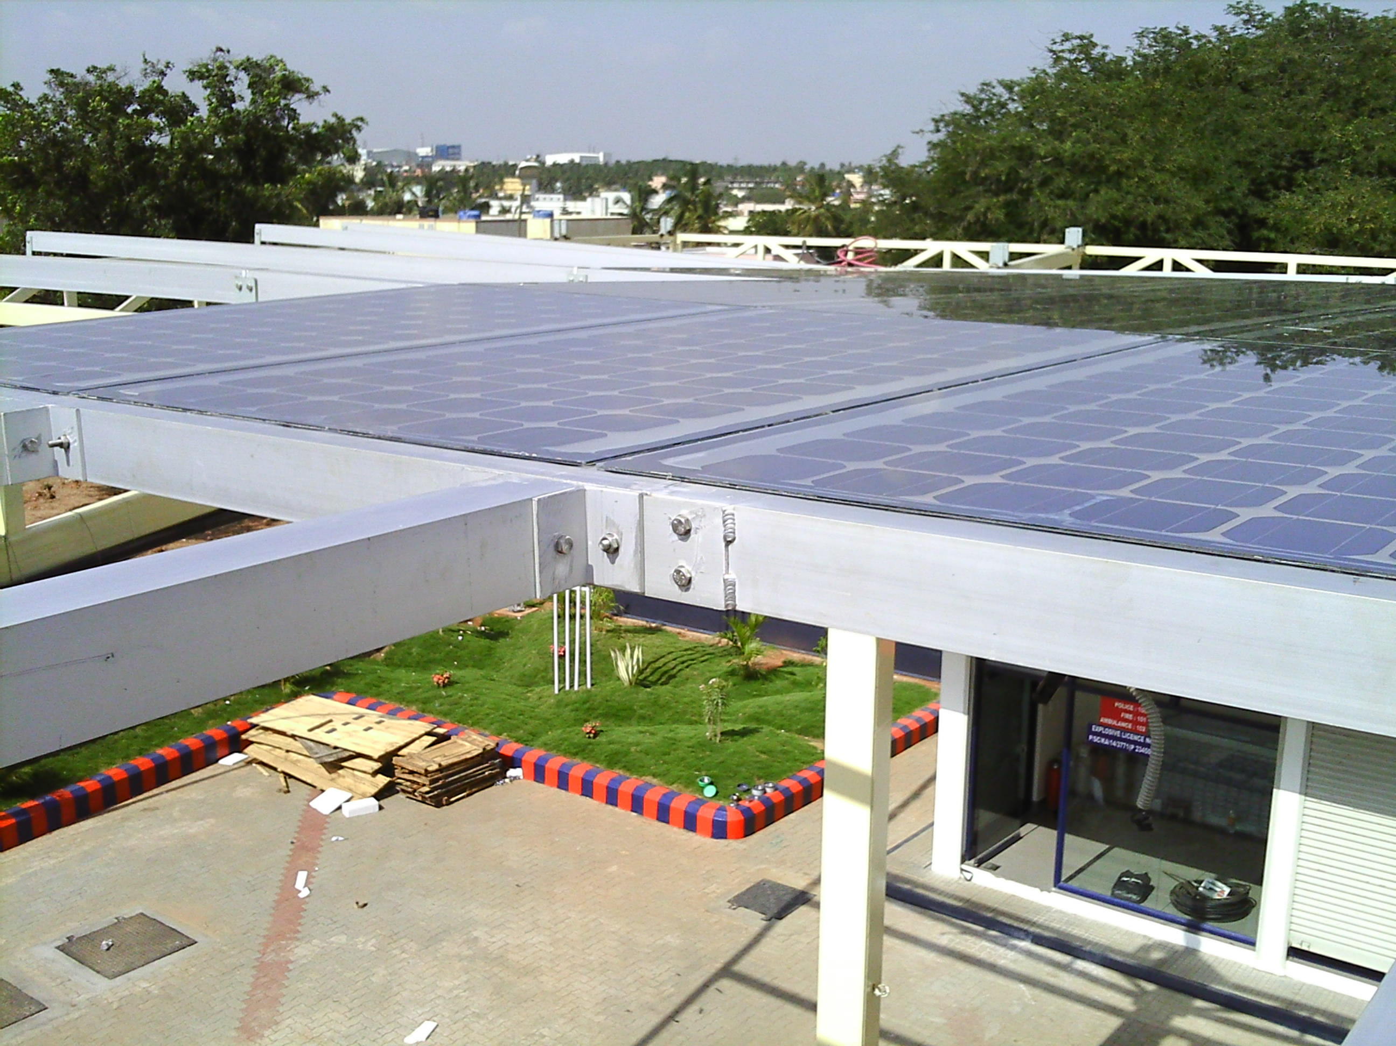
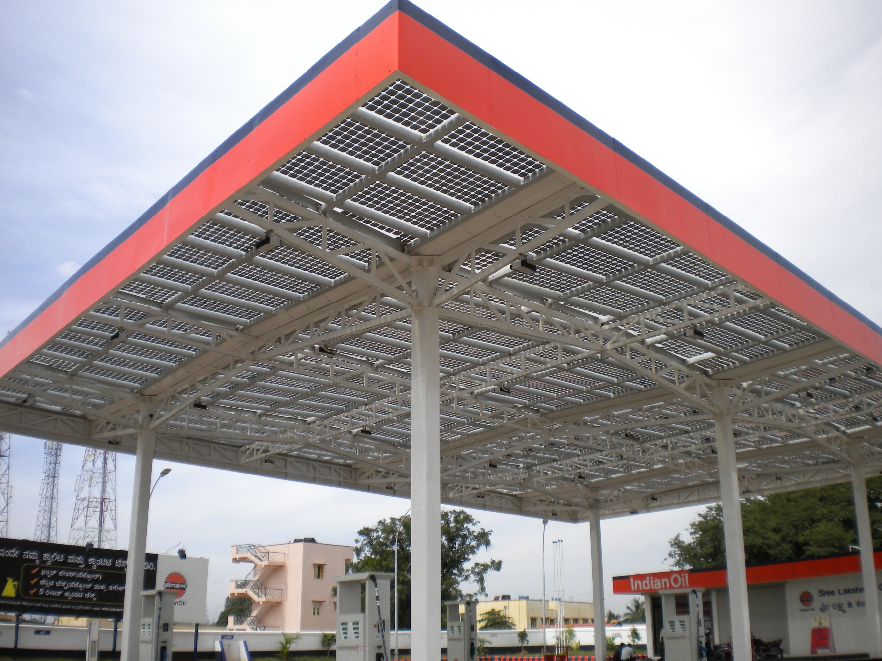
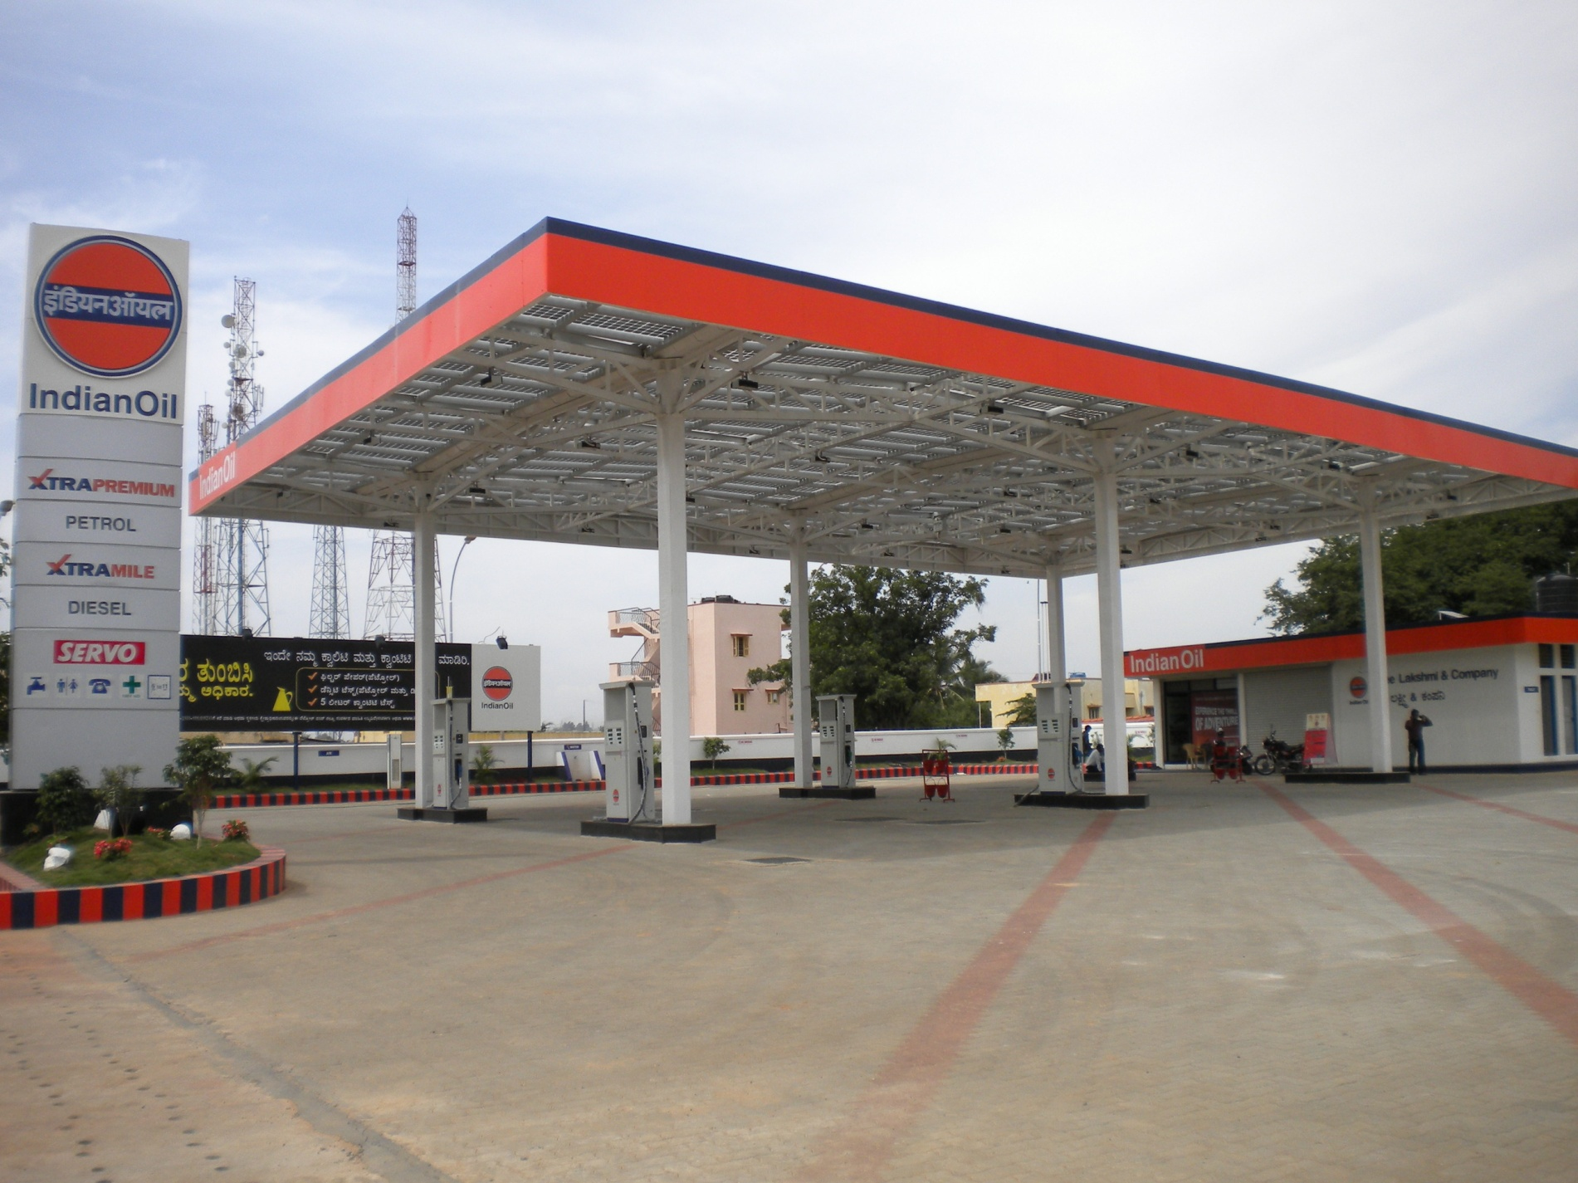

Slide 8

Indian oil petrolium bangalore

Slide 9
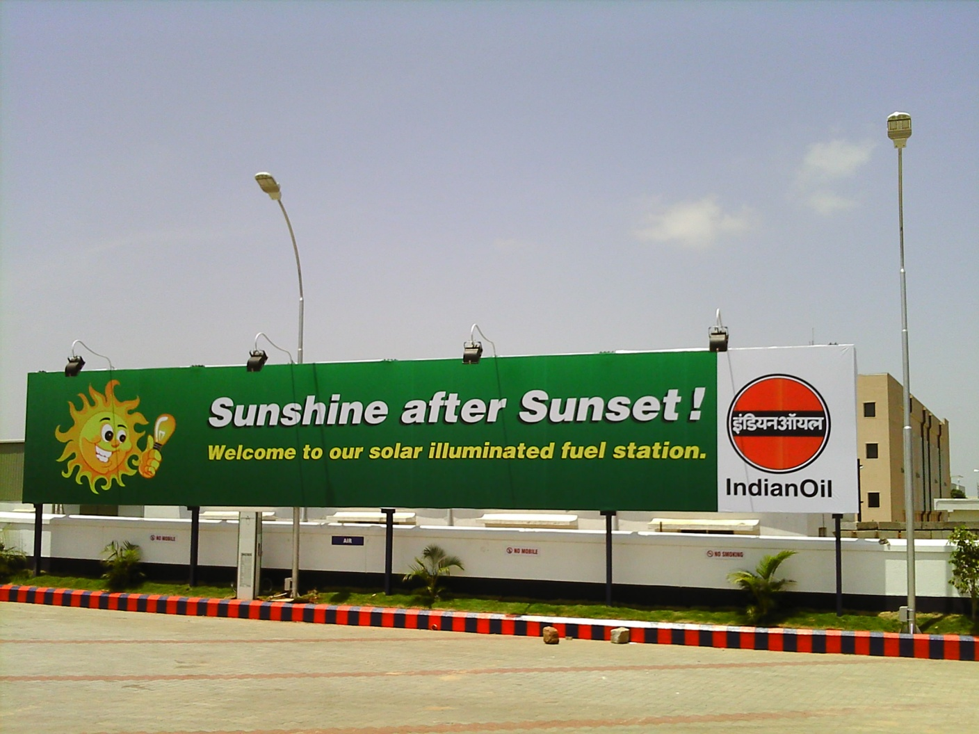

Slide 10
